Slide 1


Slide 2
Database Management Systems
Week 7, Day 1
MongoDB—Aggregate Functions
Atta Muhammad
+92-333-1971110
attapanhyar@quest.edu.pk

Slide 3
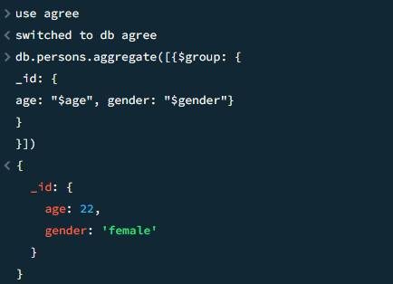
Nested Group BY

Slide 4
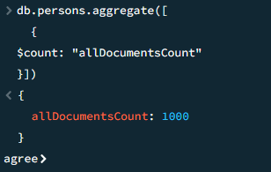
$count

Slide 5
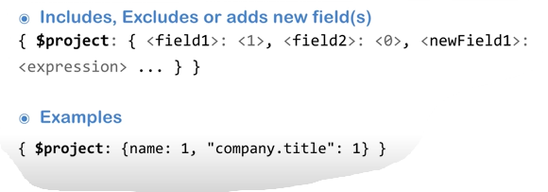
$project

Slide 6
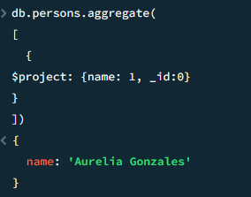
$project Example

Slide 7
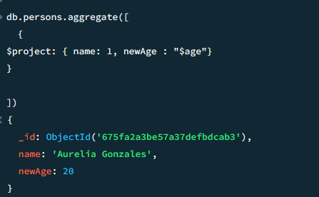
$project Example

Slide 8
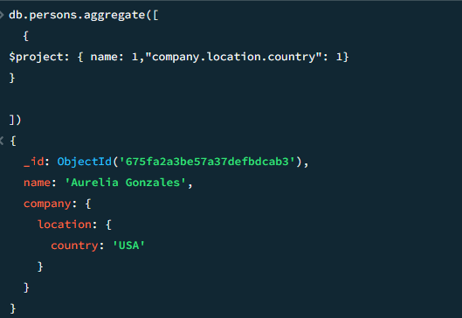
$project Examples

Slide 9
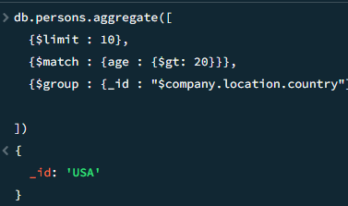
$limit

Slide 10
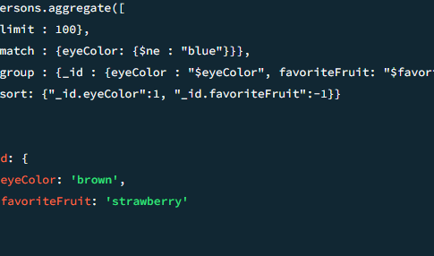
$limit Examples

Slide 11
Question(s)

